Slide 1
Guidelines for bio template – content and layout
Faculty bios help identify that Emeritus programs are delivered by subject matter experts within their chosen fields. Some clients may request multiple faculty bios from which they select one final faculty. Therefore, this is your opportunity to market your expertise with all your relevant credentials in the best possible way
Guidelines
Please ensure that your bio demonstrates and highlights relevant expertise and aligns with the outlines that you will be submitting. The following information is crucial for a high-quality bio:
List all your teaching expertise - separated with a “|” - avoid repetitive descriptors
List all the Business Schools and educational institutions you are/have been affiliated with – very important for our Middle East and India clients
List all clients you have worked with in APAC, India, EU, META, US and LATAM
List of books, publications/case studies/methodologies/examples you’ve used in your sessions
List of Ted Talks, conferences, summits you have spoken at with high quality video links that best represent you in delivery mode – our clients always request these
Include any languages and dialects you can teach/facilitate in - particularly for the META, LATAM and APAC region
For “current/former position” we advise not to use titles such as “Co-Founder / CEO” of your own business entity Examples of meaningful titles include:
Existing senior role at a well-established company including senior title, advisor, board member, etc
Academic roles (including visiting or adjunct roles) at a university or other higher education provider
Previous C-level employment or unique roles at large companies / specific industries. Example: Former medical doctor, Former Telstra CEO, Ex-NBA player, Former Olympian, etc.
Each bio page should consist of no more than 5 logos.
Core Expertise: Please list up to 3 areas of expertise where you have 2-3 days of content/material.
Sub Topics : Please list all areas of expertise where you can delivery up to 1 day's content.

Slide 2
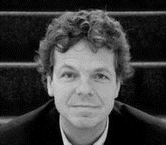
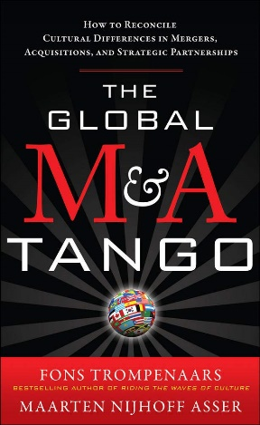


Maarten Asser
Faculty and coach
Adjunct Faculty in Executive Development, Tuck School of Business, Dartmouth University
An Intellectual Property Lawyer turned Organizational Change and Leadership Development Consultant and Executive Coach. For over 12 years led the team at Trompenaars-Hampden-Turner (THT) Intercultural Management Consulting in the United States, based in Cambridge, Massachusetts. Now, he designs, develops, and facilitates leadership and executive development and action learning programs and engages in consulting projects in the area of cross-cultural competence, integration, strategic cultural alignment, and executive team facilitation through effective communication and decision making
Teaches in Executive Education Programs at Tuck School of Business, Emeritus, The Indian School of Business, Duke Corporate Education, Nova SBE (Lisbon-Portugal), and Sasin School of Management (Bangkok-Thailand). Has been visiting faculty at IPADE in Mexico, Harvard Business School, and Columbia University's Graduate School of Business. Co-author of “The Global M&A Tango: Cross Cultural Dimensions of Mergers” and “Acquisitions and 21 Leaders for the 21st Century”. 10 years in the international scientific, technical, and medical publishing industry
Industry specific experience as a practitioner and/or educator across globe:
Future Focused Leadership | Strategy = Innovation Scenario Planning Leading Change & Creating a Movement
Click to view
Click to view
Adaptive & Resilient Leadership Resilient Organizations | Global Leadership & Intercultural Competence | Organizational & Leadership Tensions Turning Tensions into Value | Dilemma Management Action Learning Programs | High Performance Teamwork Organizational Cultural Intelligence Learning Process Improvement
Click to view
Industry | Companies
Pharma & Biotech | Novartis, UCB, Genzyme
IT & Technology | Corning, Intel, IBM, GENPACT
Telecommunications & Media | Telenor, Thomson Reuters
Banking & Finance | Goldman Sachs, ABN AMRO, HSBC, SCB, ING
Government | Dubai Govt.
Manufacturing | Tata & Sons, Mahindra, Aditya Birla Group
Energy | Hydro
Food Processing & Hotel | Campofrio, DSM, Starwood Hotels
Masters of Law in Intellectual Property and International Organizations
MBA, Innovation, Theseus International Management Institute in Sophia Antipolis, France
Boston, USA / Nice, France

Slide 3
Name
Current/Former Positions with strong brands and meaningful titles
Experience
Industry specific experience as a practitioner and/or educator across globe:
XXXX
Click to view
Click to view
XXXX
Click to view
Industry | Companies
XXXX
XXXX
Location

